Slide 1
JavaScript Training
OOJS

Slide 2
01
02
03
04
05
06
Terminology
Prototype-based programming
Namespace
Constructor
Custom objects
Inheritance

Slide 3
01
Terminology

Slide 4
Object Oriented Programming
In most languages, there are classes and objects. Classes inherit from other classes. In JavaScript, the inheritance is prototype-based. That means that there are no classes. Instead, an object inherits from another object
Notes:
Yes JS is not object oriented language be we can achieve all the object oriented feature

Slide 5
Terminology
Namespace: A container which lets developers bundle all functionality under a unique, application-specific name.
Class: Defines the object's characteristics. A class is a template definition of an object's properties and methods.
Object: An instance of a class.
Property: An object characteristic, such as color.
Method: An object capability, such as walk. It is a subroutine or function associated with a class.
Constructor: A method called at the moment an object is instantiated. It usually has the same name as the class containing it.
Inheritance: A class can inherit characteristics from another class.
Encapsulation: A technique which involves bundling the data and the methods that use the data together.
Abstraction: The conjunction of an object's complex inheritance, methods, and properties must adequately reflect a reality model.
Polymorphism: Poly means "many" and morphism means "forms". Different classes might define the same method or property.
Notes:
Yes JS is not object oriented language be we can achieve all the object oriented feature

Slide 6
02
Prototype-based programming

Slide 7
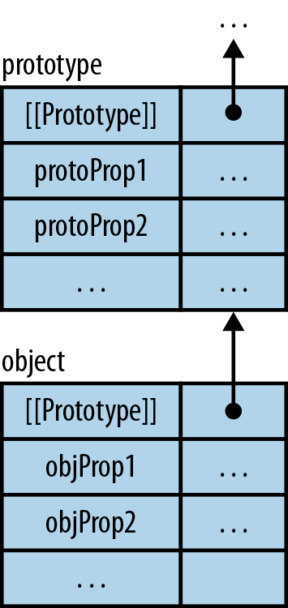
Object Oriented Programming
Object-oriented programming (OOP) is a programming language model organized around objects rather than "actions" and data rather than logic. Historically, a program has been viewed as a logical procedure that takes input data, processes it, and produces output data
JavaScript can have all that an Object-Orientated language has to offer.
Notes:
Yes JS is not object oriented language be we can achieve all the object oriented feature

Slide 8
03
Namespace

Slide 9
Namespace
A namespace is a container which allows developers to bundle up functionality under a unique, application-specific name.
Need
creates one global object, and all variables, methods, and functions become properties of that object
Reduce the number of objects and functions that are added to the global scope in our applications.
reduces the chance of name conflicts in an application
var MYAPP = MYAPP || {};
Notes:
Yes JS is not object oriented language be we can achieve all the object oriented feature

Slide 10
04
Constructor

Slide 11
Constructor
factories for objects
a rough analog to classes in other languages.
by convention, the names of constructors start with capital letters.

Slide 12
05
Custom objects

Slide 13
A JavaScript object is a collection of name/value pairs called “properties”
There is no keyword class in JavaScript
How to create class like signature in JavaScript?
JavaScript uses functions as constructors for classes. Defining a class is as easy as defining a function. var Person = function () {};
How to create object (Instance of a class)?
Using object literal var person1= {}
Using constructor - var person1 = new Person(); var person2 = new Person();
Using object.Create - var person1 = object.create(Person.prototype);
Object can have properties, any property created with constructor will be available in all the instances.
Object can have Method, means functions as properties
Notes:
JavaScript is designed on a simple object-based paradigm. An object is a collection of properties, and a property is an association between a name and a value. A property's value can be a function, in which case the property is known as a method. In addition to objects that are predefined in the browser, you can define your own objects.

Slide 14
06
Inheritance

Slide 15
Inheritance in JavaScript can be achieved via prototype chain
This can be simple described by var inheritsFrom = function (child, parent) { child.prototype = Object.create(parent.prototype); child.prototype.constructor = child.constructor };
JavaScript does not detect the child class prototype.constructor so we must do it manually
Notes:
JavaScript is designed on a simple object-based paradigm. An object is a collection of properties, and a property is an association between a name and a value. A property's value can be a function, in which case the property is known as a method. In addition to objects that are predefined in the browser, you can define your own objects.

Slide 16
Notes:
TITLE PAGE (ALT)

Slide 17
Thank You
Contact Info

